Slide 1
FINAL PRESENTATION TEAM TAPSCOTT
HVA Blockchain minor

Slide 2
TABLE OF CONTENTS
Team tapscott
THE PROJECT
BACK END
FRONT END
DEMO
How the project went, the decisions we made and why.
The backend of the application, what services we used and why.
The front end of the application, what style decisions we made.
A demo of the entire flow of the application.

Slide 3
THE PROJECT
Team tapscott
SMART CONTRACT TRIGGERED PAYMENT
We first looked at if it was possible to create a system that pays fiat automatically once a certain smart contract criteria was met.
CENTRALIZED PAYMENT SYSTEM
Then we looked at a system where a centralized player would be involved.
FIAT PAYMENTS TRACKED ON THE BLOCKCHAIN
Lastly we looked at tracking payments on the blockchain.

Slide 4
THE PROJECT
Team tapscott
DONATION
RECEIVED
WAIT
OUTGOING
HELP
Someone makes a donation which can be seen on the blockchain.
The charity receives the donation.
The charity can then wait until it has enough funds to pay other parties.
Once the charity has enough funds it pays the party needed.
The party helps the charity create a better world

Slide 5


BACKEND
Team tapscott
Architecture
Ethereum
Ganache
Nodejs
Express
Ngrok

Slide 6
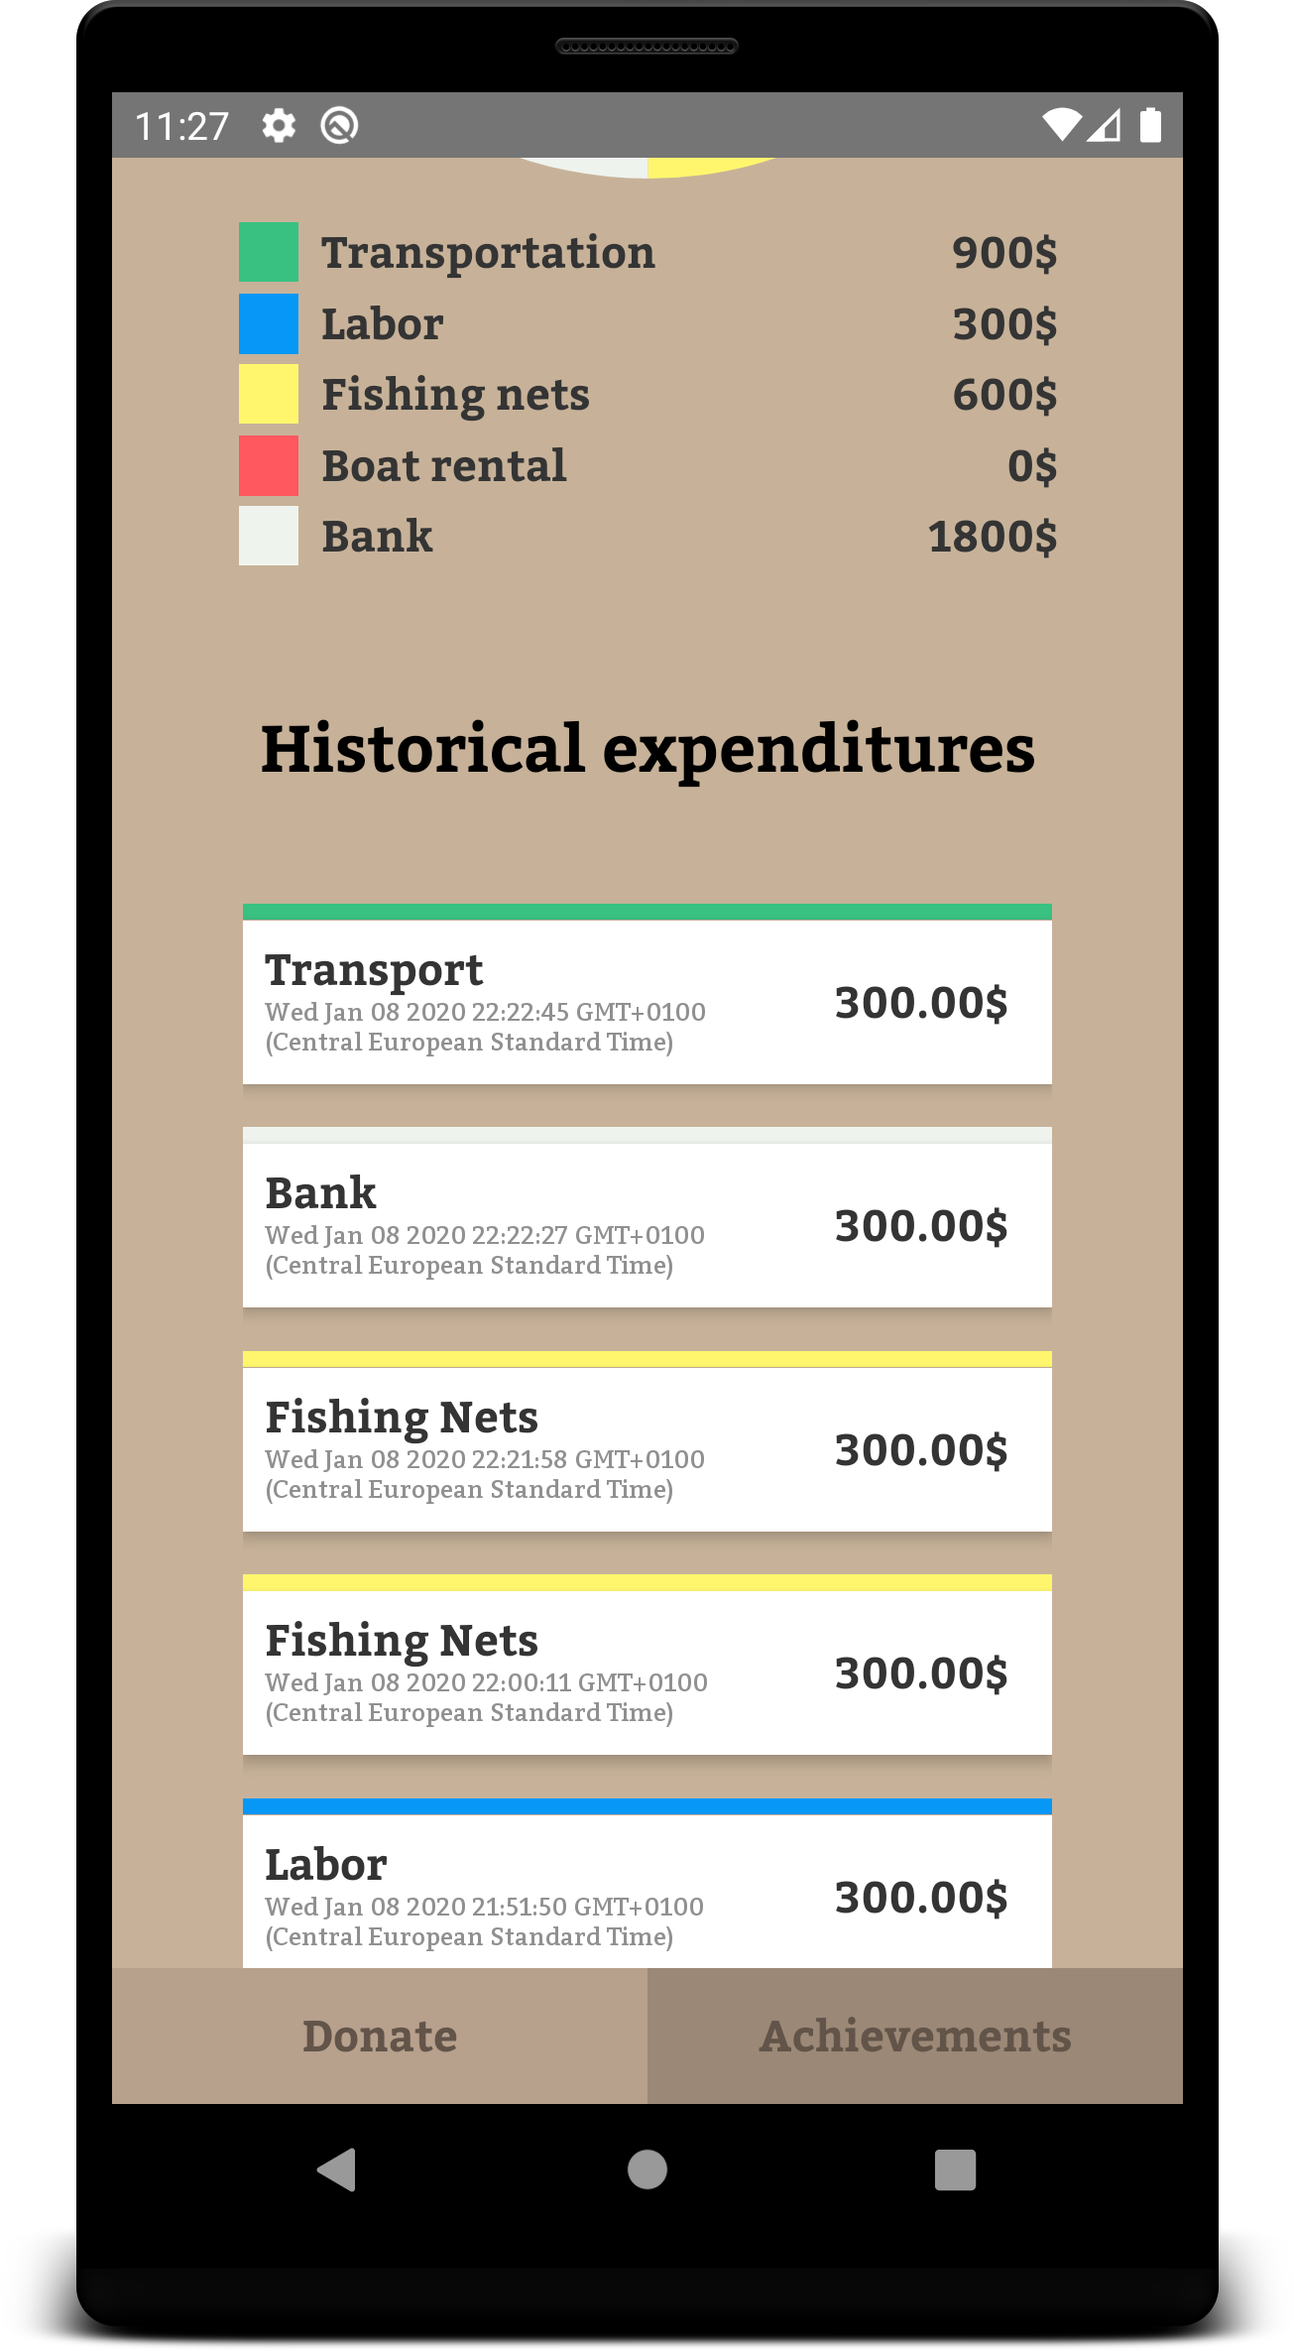
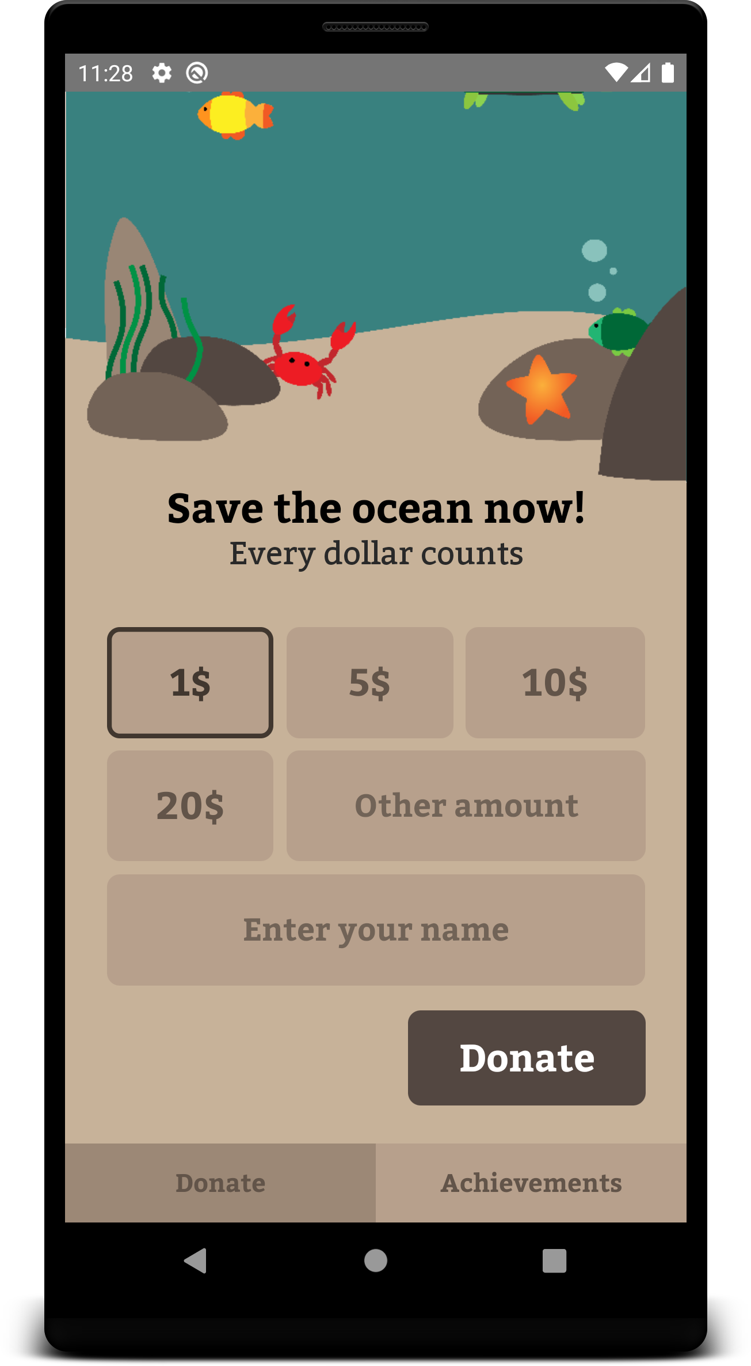
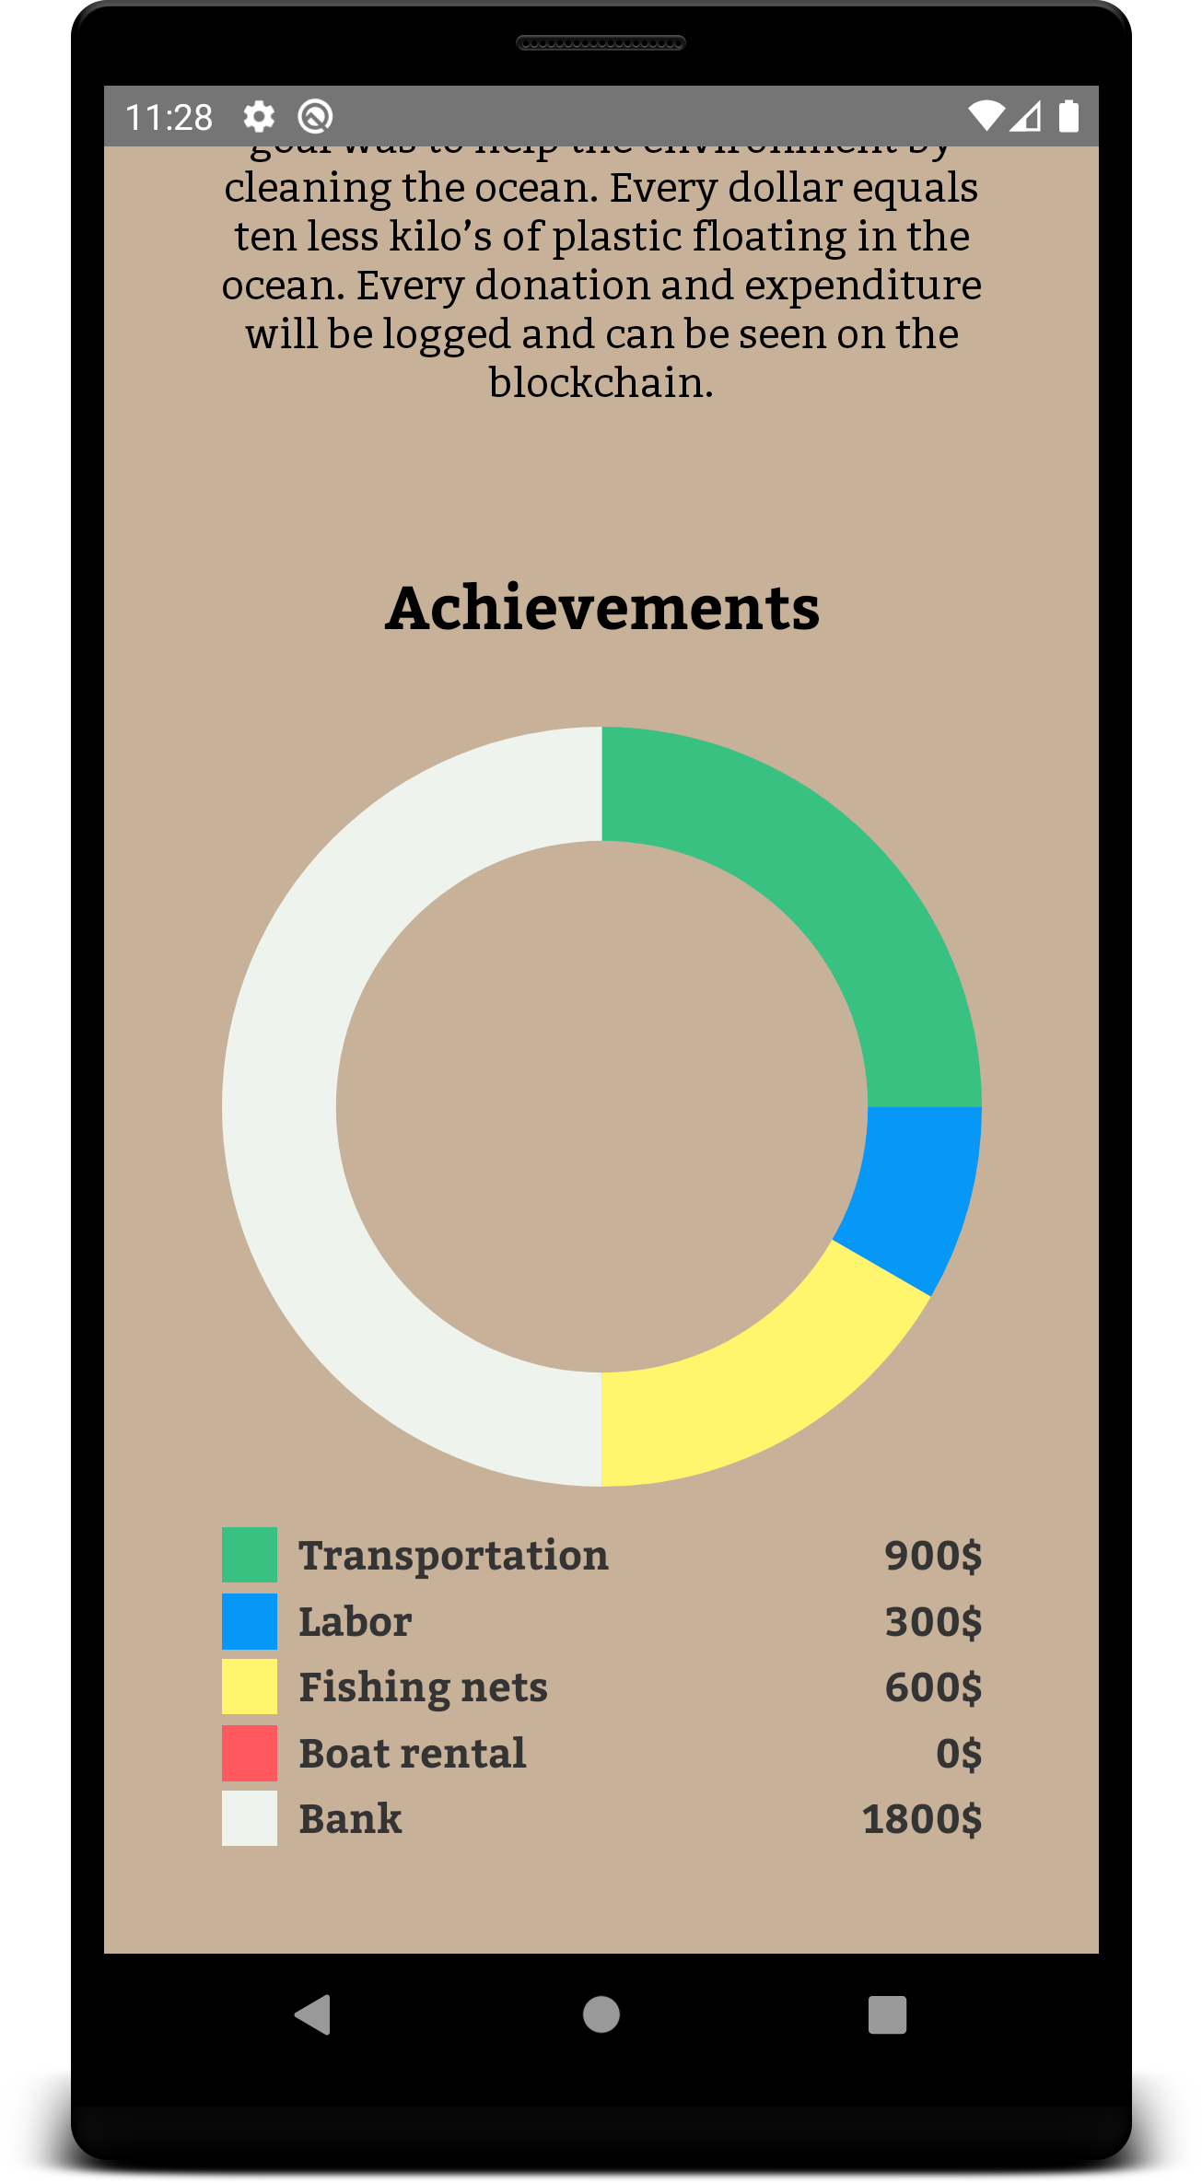
React-Native
Redux
Redux-Saga
Axios
Flexbox
FRONTEND
Team tapscott

Slide 7
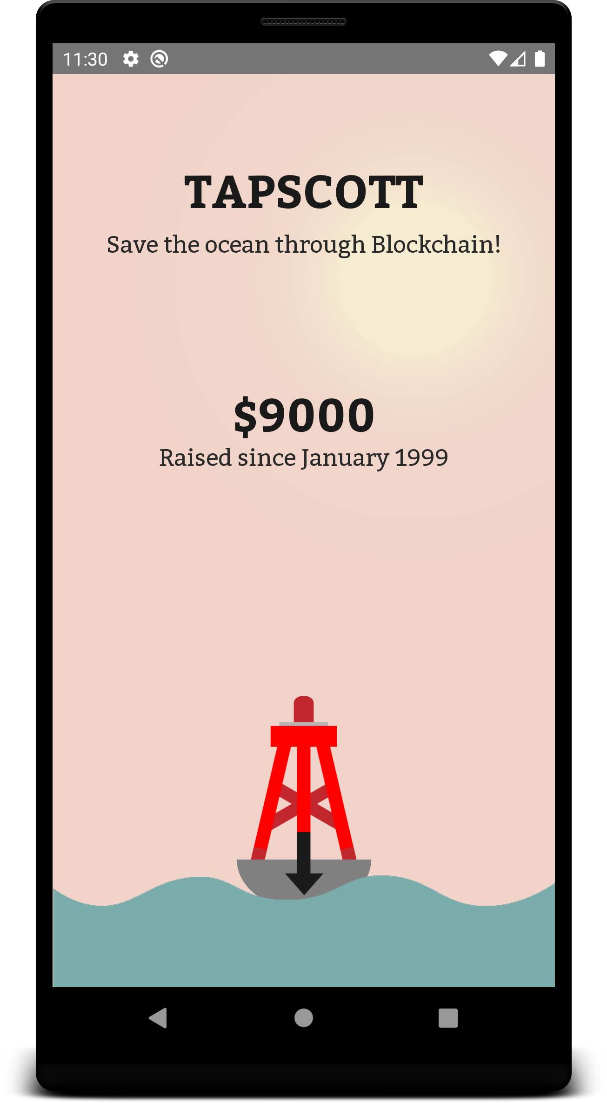
DEMO
Team tapscott

Slide 8
THANK YOU!
Any questions?

